Slide 1
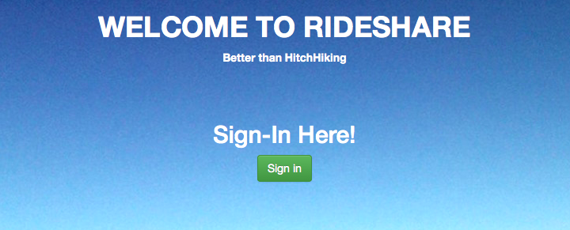

Team #NoLife Rideshare Application
CMPS115 – Project Presentation
12/3/15
Alice Yu
Alix Feinsod
Brighton Keslin
Carol Figueroa
Christopher Peck
Timothy Ma
Team #NoLife
Notes:
Alix , Tim introduces Chris

Slide 2

Problem Statement 1
Facilitate ride sharing
Help reduce greenhouse gasses
Team #NoLife
Notes:
Chris, introduces Carol
Empty cars and overcrowded buses

Slide 3
Problem Statement 2
Types of Users:
People who can give rides: Can add offered rides
Can search for riders
People who need rides:
Can add needed rides
Can search for drivers
Team #NoLife
Notes:
Carol, introduce Alix

Slide 4
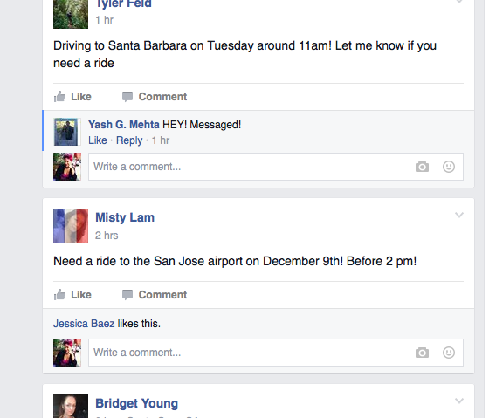
UCSC Rideshare Facebook Page
Not organized
Not searchable
Misunderstandings and arguments
Team #NoLife
Notes:
Alix 2

Slide 5
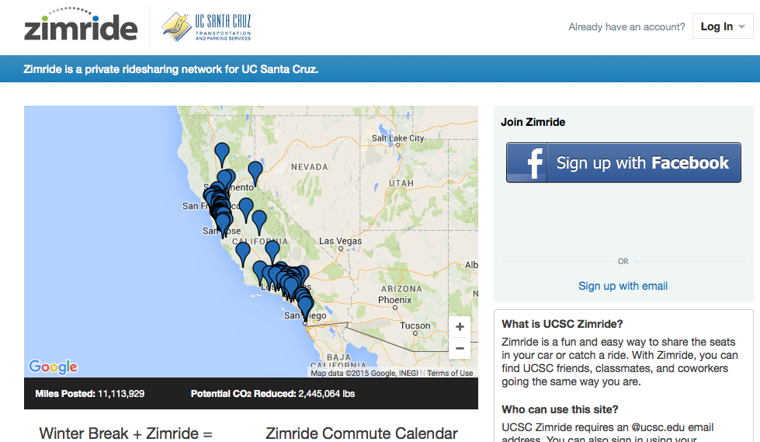
Zimride
Confusing
Not used enough
Team #NoLife
Notes:
Alix, Introduce Alice

Slide 6

Sprint 1 Challenges
Choosing a platform to develop on
Communication
Team #NoLife
Notes:
Alice and Chris, Alice introduce Tim

Slide 7
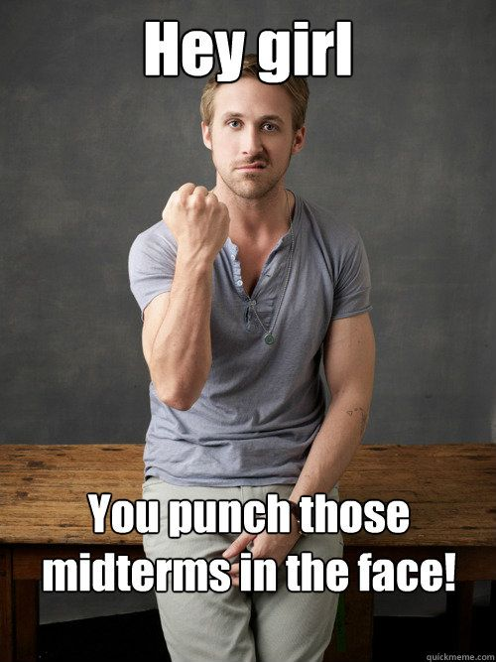
Sprint 2 Challenges
Understanding Google’s APIs
Difficulty with Google login
Midterms
Group meetings were shorter
Everyone had midterms different days
Team #NoLife
Notes:
Tim and Carol, Carol Introduce Brighton
Maybe we can talk about how we couldn’t connect the google login api with the database?
No one in our team had worked with google api’s before right? I had Brighton!!
Should we add more Challenges for Sprint 2? no

Slide 8

Sprint 3 Challenges
Time crunch
Multitude of final deliverables
Inconvenient holiday time
Team #NoLife
Notes:
Alix and Brighton, Alix introduces demonstration

Slide 9
Demonstration
Team #NoLife
Notes:
All

Slide 10
It’s now live at:
http://rideshare-1098.appspot.com/
Team #NoLife
Notes:
All

